Slide 1
PROJECT : NC Census Data vs COVID19 Analysis
TEAM: Game Of Threads
(Heba, Karine, Gregory, Sashi)

Slide 2
Summary
The project has the following goals:
Use Census data to establish correlation with demographics & Covid_19 data:
The top 10 counties that got affected with Covid19
Understand correlation between the following:
Population Vs Confirmed cases
Median Age Vs Confirmed cases
Median age Vs Death
Household Income Vs Confirmed cases
Develop Heatmap for Confirmed & Death cases in North Carolina by county

Slide 3
Implementation Approach
Researched the following data:
Zillow Housing data – Received 500 error
Google API Bank data – 20 results Google limitation
Census API data – Extensive research i.e API’s, Restful API’s, zipcodes etc.
Covid19 data to obtain Covid19 data API
Obtained data from the data sources
Merged the data into pandas data frame
Generated, plots, correlation coefficients, analyzed the data based on the hypothesis.

Slide 4
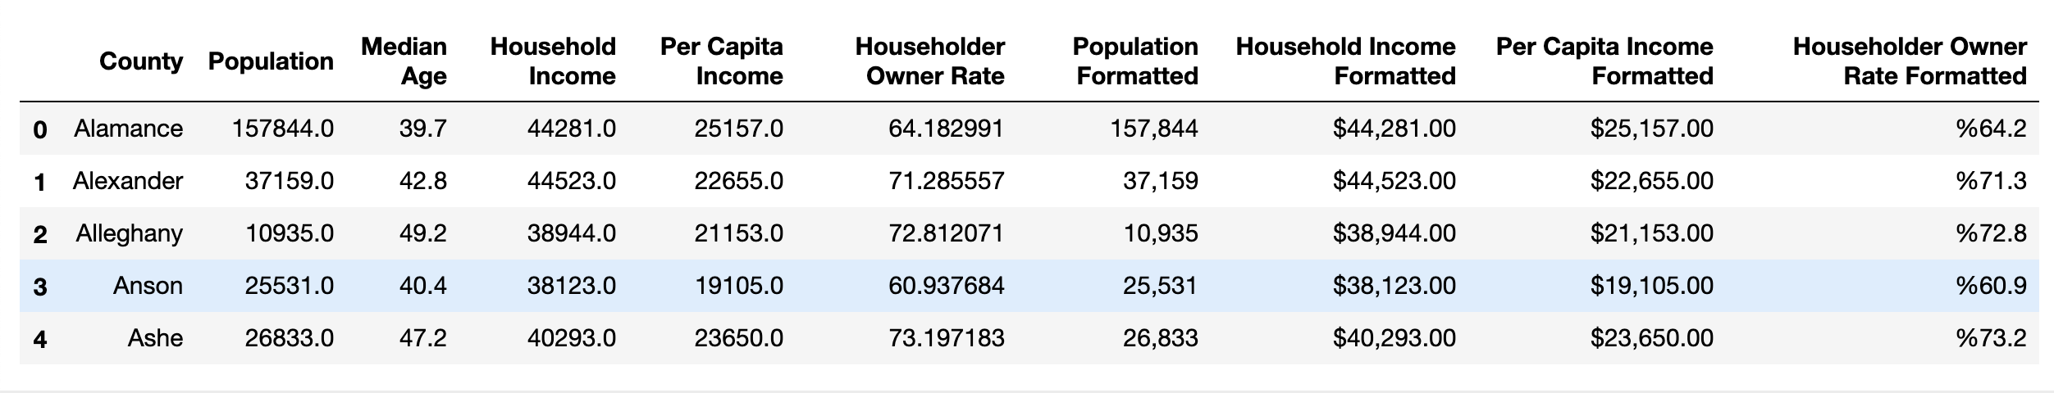
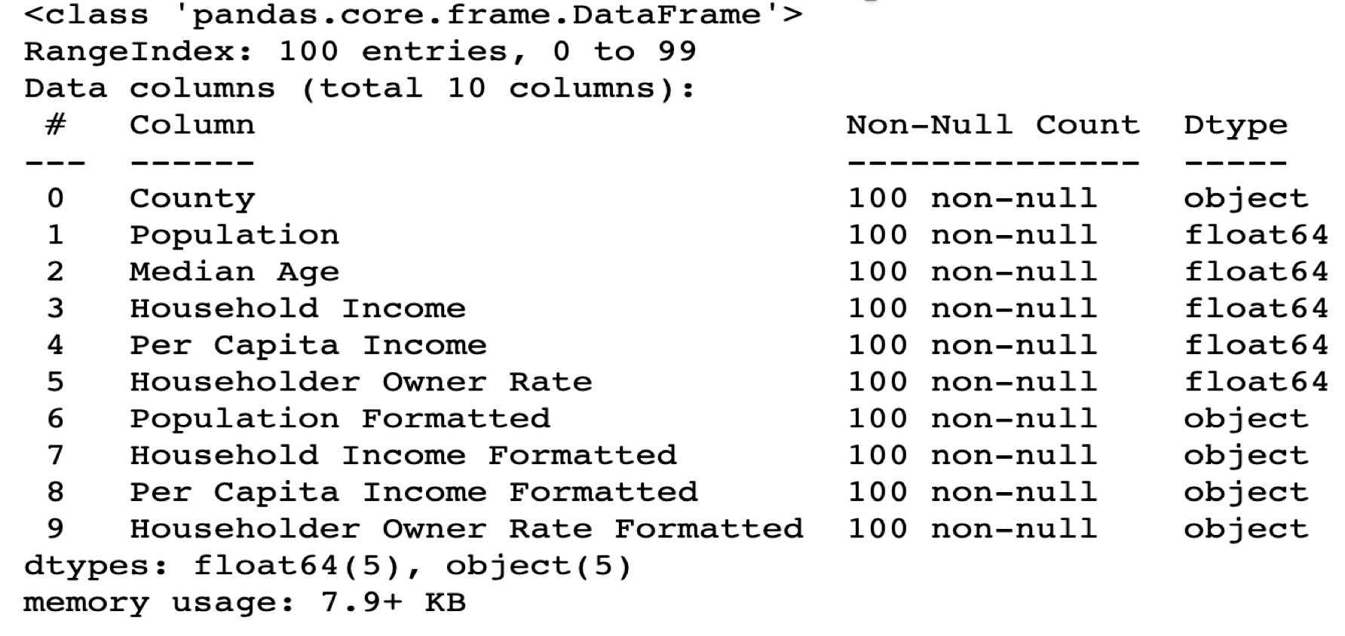
Data Set 1 – Census Data

Slide 5
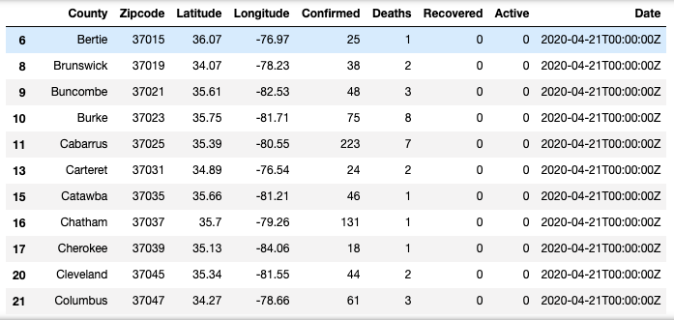
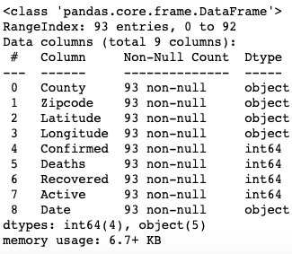
Data Set 2 – Covid19 Data

Slide 6
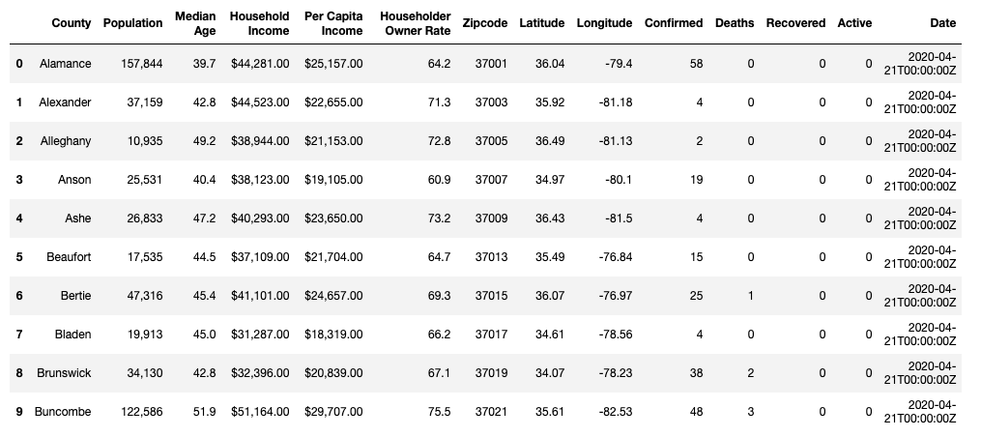
Data Set 3 – Merged Data

Slide 7
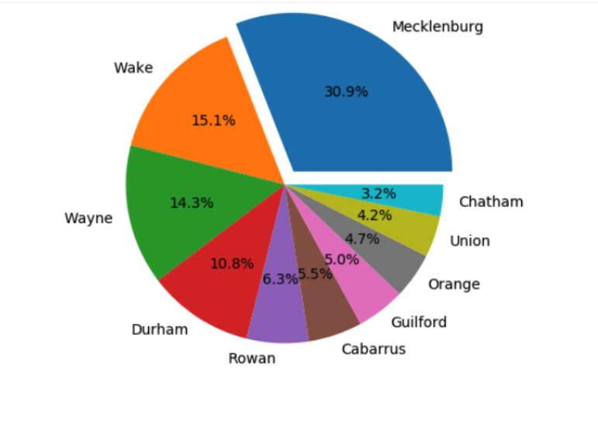
Top 10 Counties With Covid19 Confirmed Cases

Slide 8
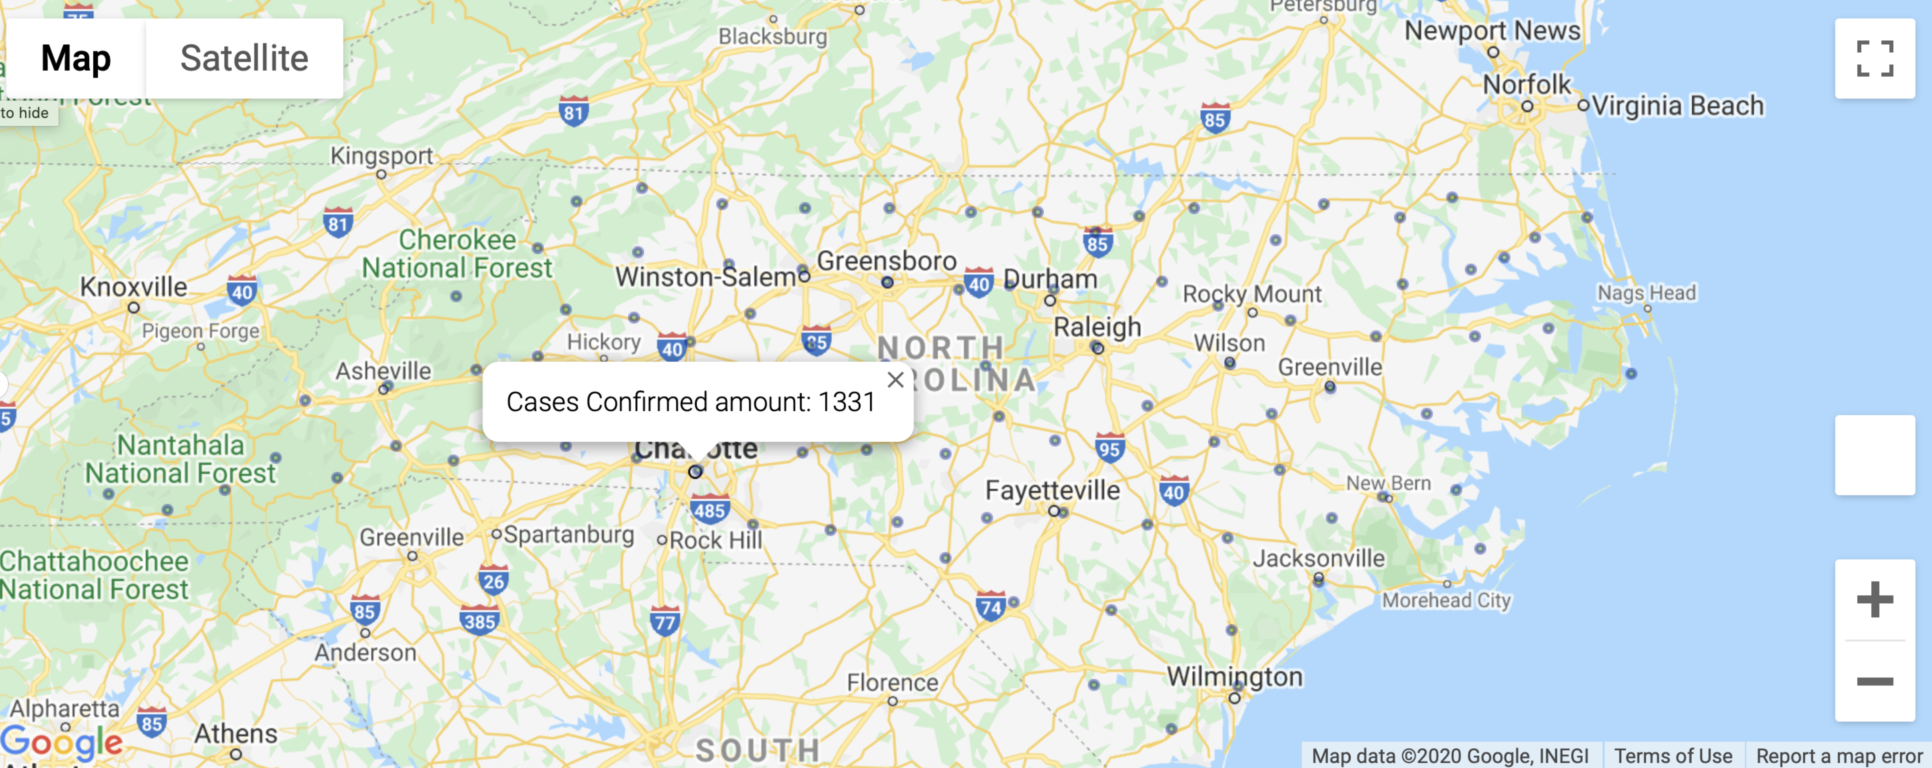

Confirmed Cases By County

Slide 9
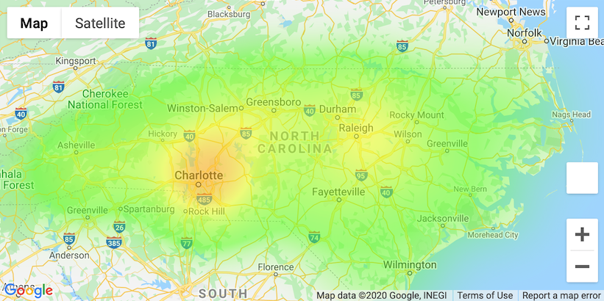
Heat Map Death Cases By County

Slide 10
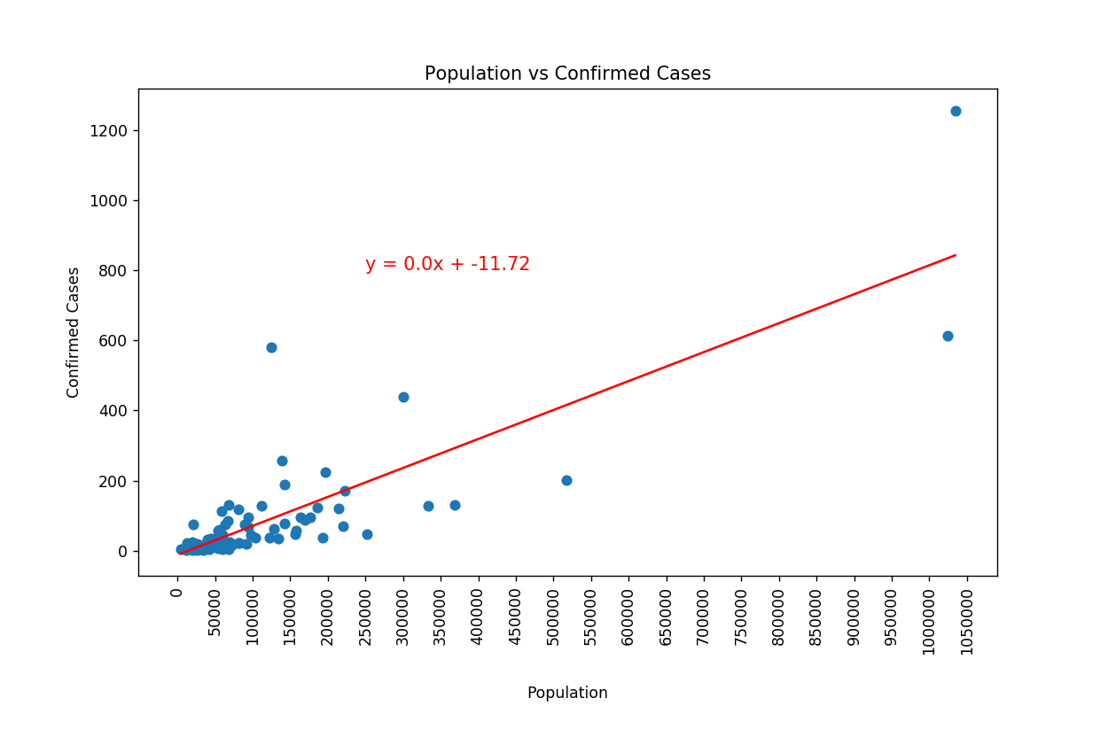
Correlation : Population vs Confirmed cases
R value = 0.83139
R*R value= 0.6912086
P value =4.7367e-25

Slide 11
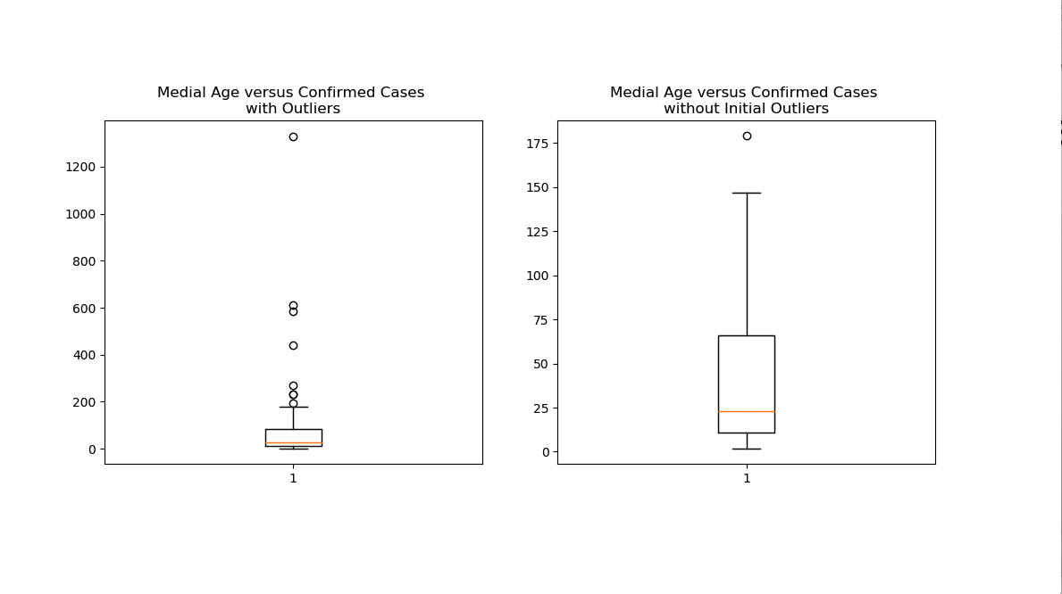
Correlation: Median Age vs Confirmed

Slide 12
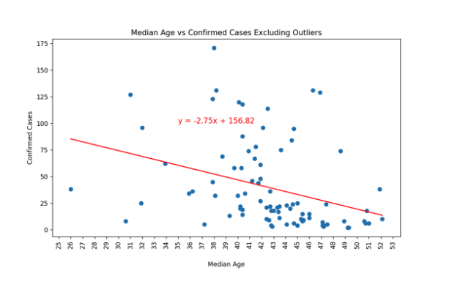
Correlation: Median Age vs Confirmed Cases
R value: -0.3399
R*R value: 0.1155
P value: 0.0014

Slide 13
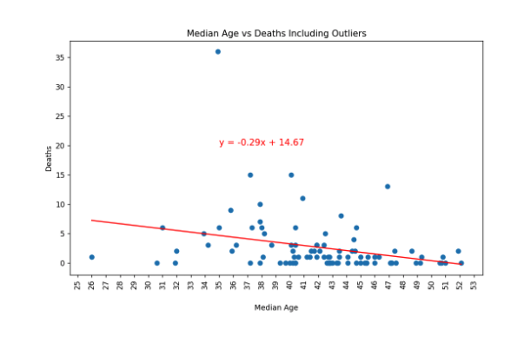
Correlation: Median Age vs Death
R value : -0.2994
R*R value: 0.08964
P value: 0.003552

Slide 14
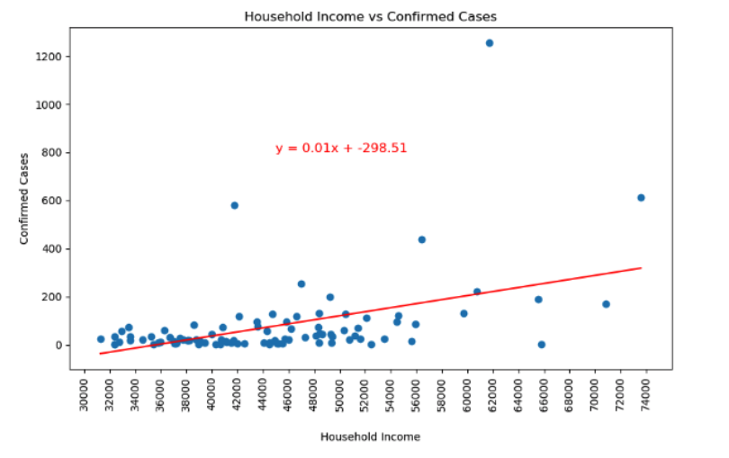
Correlation: Household Income Vs Confirmed
R value :0.448
R*R value: 0.2015
P value: 6.4182e-06

Slide 15
DATA SOURCES
C = Census(census_key)
census_data = c.acs5.get(("NAME", "B01003_001E","B01002_001E", "B19013_001E","B19301_001E","B07013_002E"),
{'for': 'county:*','in': 'state:37'})
https://api.covid19api.com/dayone/country/united-states

Slide 16
Conclusion
Based on the statistical analysis the following was determined:
Population data was useful for covid_19 analysis
Median age, Median income was not significant enough to analyze covid19_data

